Slide 1

ONTOLOGICAL SEMANTIC SEARCH ENGINE
Presented By,
SHREYA KAMPLI
VARUN JOSHI
Free Powerpoint Templates

Slide 2
AGENDA
  INTRODUCTION
  TECHNOLOGIES
  SYSTEM MODEL
  WORKING
  REFERENCES

Slide 3
INTRODUCTION
Search Engine is the most important tool to discover any information in World Wide Web.
In a row with the traffic growth of web, traditional search engine nowadays is not appropriate anymore to be used so hence we move on to semantic search engines.
Semantic technologies promise a next generation of search engines which promise to produce precise.

Slide 4
What is Semantic Web?
The Semantic Web is the representation of data on the World Wide Web.
It is based on the Resource Description Framework (RDF), which integrates a variety of applications using XML for syntax and URIs for naming. – W3C Semantic Web.
It uses RDF encoded Semantic Web documents which are searched in response to a user query for exact results.

Slide 5
Ontology
Ontology is an explicit specification of some topic.
For our purposes, it is a formal and declarative representation which includes the vocabulary for referring to the terms in that subject area and the logical statements that describe what the terms are, how they are related to each other, and how they can or cannot be related to each other.
Therefore, Ontology provides a vocabulary for representing and communicating knowledge about some topic and a set of relationships that hold among the terms in that vocabulary

Slide 6

Resource Description Format(RDF)
RDF is an abstract model, a way to break down knowledge into discrete pieces .
The basic data model consists of three object types: Resources, Properties, Statement
Resources: All thing being described by RDF expressions are called.
Properties: A property is a specific aspect, characteristics, attribute or relation used to describe a resource.
Statement: A specific resource together with a named property plus the value of that property for that resources an RDF statement.
For example: article is authored by Uche Ogbuji. A subject ("this article"), a predicate ("is authored by"), and an object ("Uche Ogbuji").

Slide 7
ACRONYMS AND ABBREVATIONS
RDF: Resource Description Framework
XML: Extensible Markup Language
JSP: Java Server Pages
GUI: Graphical User interface
DOM: Document Object Model
URI: Uniform Resource Identifier
W3C : World Wide Web (W3) Consortium
URL : Uniform Resource Locator
NLP: Natural Language Processing.

Slide 8

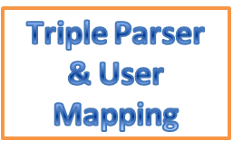



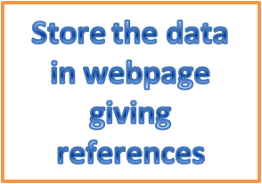
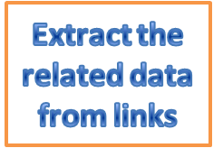
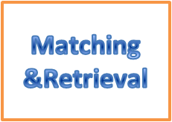

SYSTEM MODEL
Query
Triples
Google Database
XML files
Parsed files
Ontology
Data
Links

Slide 9
WORKING
Has an interface where the user enters a query.
A Triple parser to parse the input string/XML Parsing.
Triple Parsing
Parsing is the act of splitting up information into its component parts.
Example:
‘Mary feeds Spot’ parses as
Subject=Mary, proper noun
Predicate=feeds, present tense
Object=Spot, proper noun

Slide 10
3. Construction of ontology or DOM structure.
XML Parsing
XML Parser reads the XML and identifies the function of each piece of the document, and it then makes that information available in memory to the rest of the program.
While reading an XML file, a parser checks the syntax for well-formed and reports any violations.
Example: XML file:
<person corpid=”abc123” birth=”1990-11-23” gender=”female”>
<name>
<forename>abc</forename>
<surname>xyz</surname>
</name>
</person>

Slide 11
The above example parses as
Element person identified with Attribute corpid containing abc123 and Attribute birth containing 1990-11-23 and Attribute gender containing female containing
Element name containing
Element forename containing abc followed by
Element surname containing xyz

Slide 12
4. RDF parser to parse the obtained RDF files from the internet providing output as triples.
i.RDF extends the linking structure of the web to use URI’s to name the relationship between things as well as the two ends of the link.
ii. The linking structure forms a directed, labeled graph where the edges represent the named link between two resources represented by the graph nodes.

Slide 13
Consider as a simple example the sentence:
Ora Lassila is the creator of the resource http://www.w3.org/Home/Lassila.
This sentence has the following parts:
Subject (Resource) : http://www.w3.org/Home/Lassila
Predicate (Property): Creator
Object (literal): "Ora Lassila"

Slide 14
5. A sub system to match the triples obtained from the user's input query and the obtained RDF files using mixed heuristic algorithm.
6. An extractor to extract the data from the relevant links obtained after matching.
7.A display window (interface) for the user to view the outputs of the extractor.

Slide 15
REFERENCES
Kyumars Sheyks Esmaili , Hassan Abolhassani, Mahmood Neshati, and Babak Bagheri Harir “MOSSE- A Multi Ontological Semantic Search Engine”, Sharif University Of Technology, Tehran, Iran,10.1.1.61.6192, 2006
Debajyoti Mukhopadhyay,Aritra Banik.Sreemoyee Mukherjee,Jhilik Bhattacharya, ”A Domain Specific Ontology Based Semantic Web Search Engine ”, West Bengal University of Technology,Calcutta, arXiv:1102.0695v1,Feb 2011
Georges Gardarin, Huaizhong KOU, Karine Zetourni, Xiaofeng Meng, Haiyan Wang,” SEWISE: An Ontology-based Web Information Search Engine.”, 2003
Alexander Maedche and Raphael Volz,” The Ontology Extraction & Maintenance Framework Text-To-Onto”, 2009

Slide 16
ANY QUESTIONS ???

Slide 17
THANK YOU!!!!

